Slide 1


Docker - 101
Rahulkrishnan R A

Slide 2




About Me
Consultant @
Debian Contributor
Gopher
Organizer for Kubernetes Meetup Chennai
Docker 101
LinkedIn linkedin.com/in/rahulkrishnanra/
Github https://github.com/rahulkrishnanfs
Twitter https://twitter.com/rahulkrishnanra
Rahulkrishnan R A

Slide 3
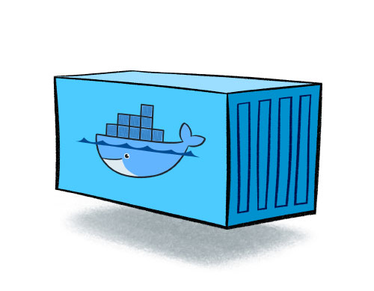

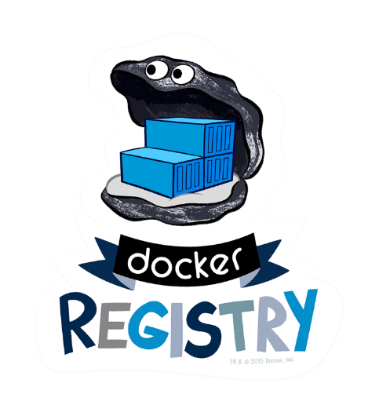
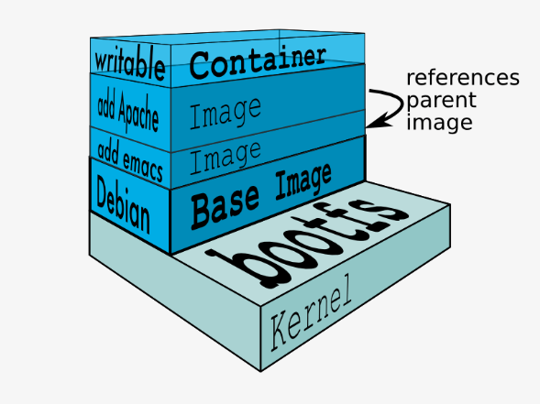
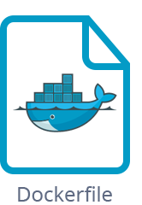
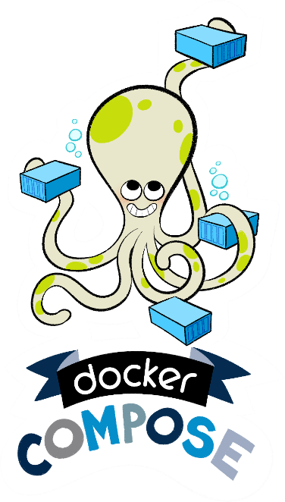
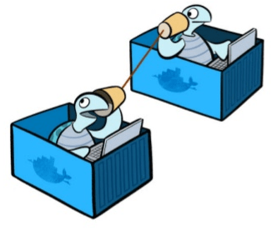

Overview

Slide 4
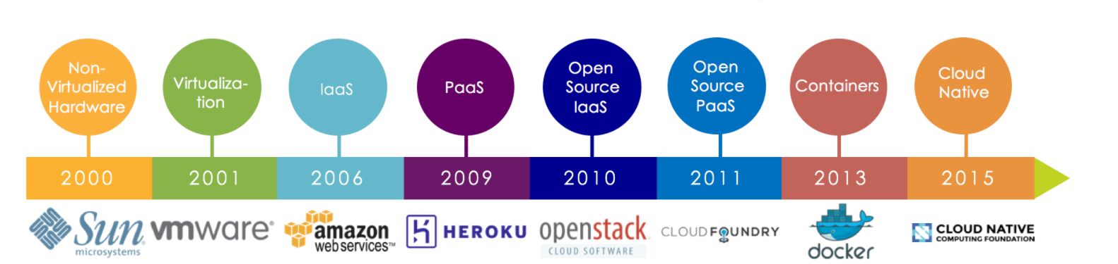
Journey to Cloud Native
http://redmonk.com/fryan/files/2016/12/cncf-history-of-comp.png

Slide 5
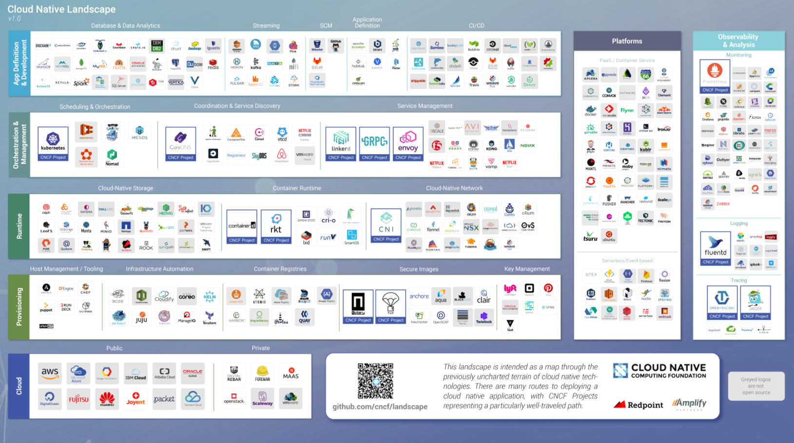
Cloud Native Lanscape

Slide 6
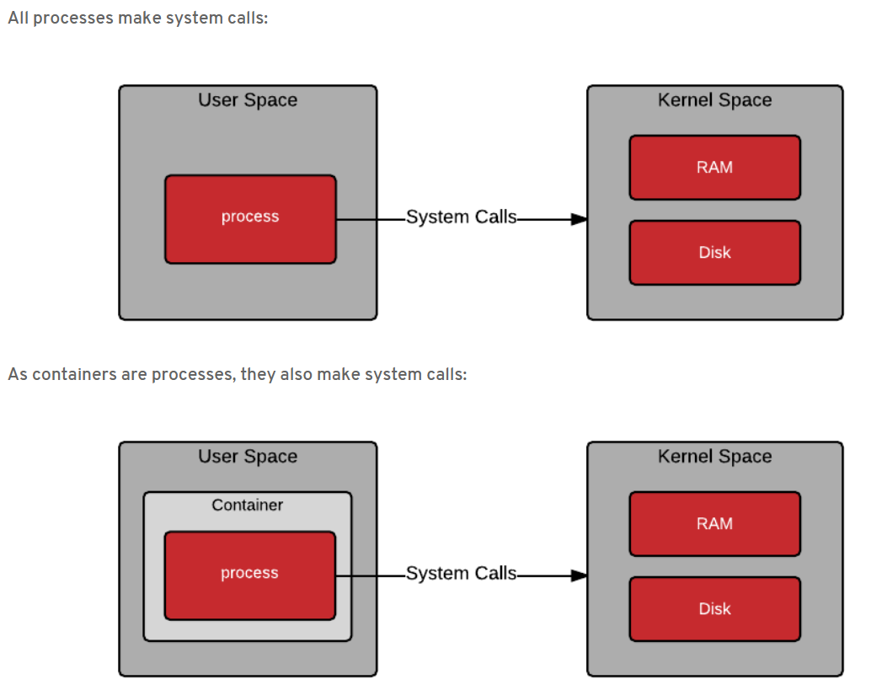
Userspace Vs Kernel Space
https://rhelblog.redhat.com/2015/07/29/architecting-containers-part-1-user-space-vs-kernel-space/

Slide 7
Isolated Containers
IPC
IPC
Network
Network
PID
PID
Hostname
Hostname
Mount
Mount
Nginx v1
Nginx v2
Container 1
Container 2
Isolation using namespace

Slide 8
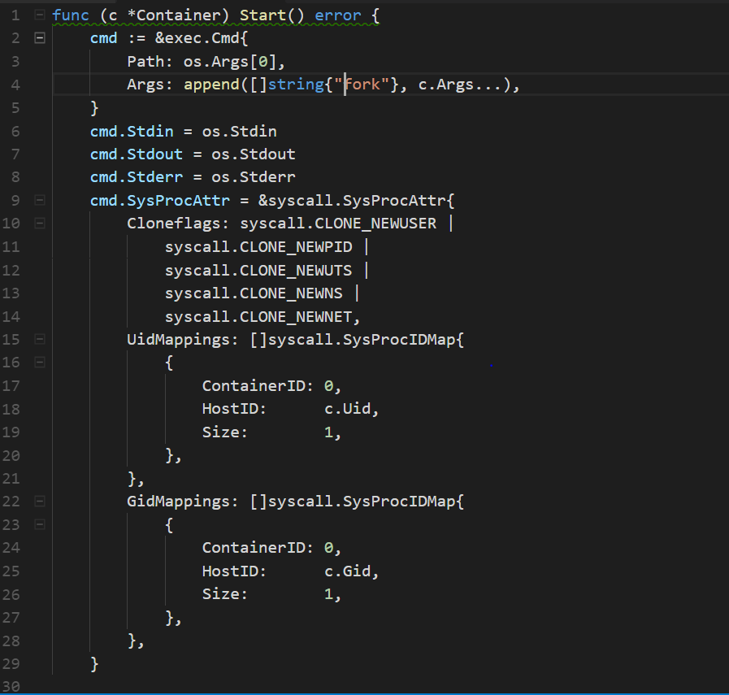

Slide 9
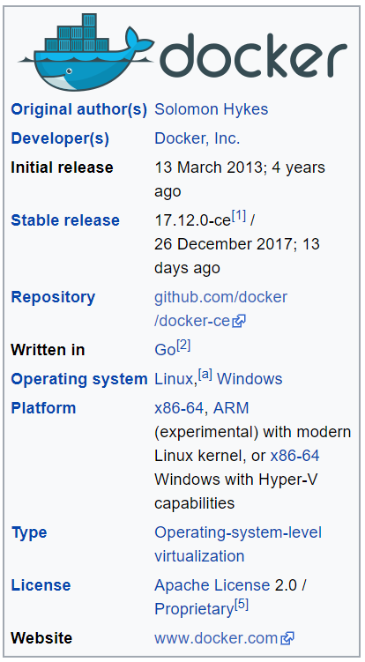
Docker Inc

Slide 10
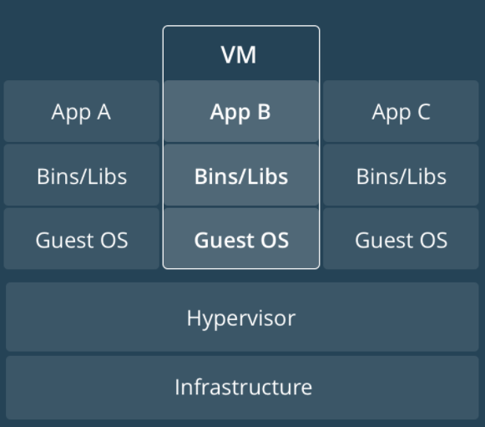
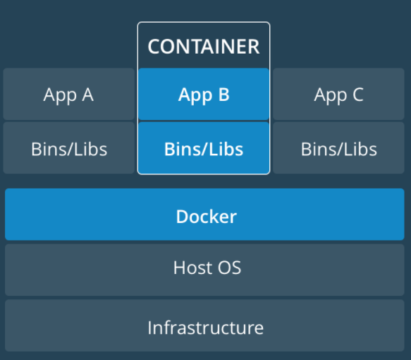
- Containers are normal process - Process executed using two Linux kernel features - Cgroups - Namespace
How containers looks like?
Virtual Machines
Containers

Slide 11
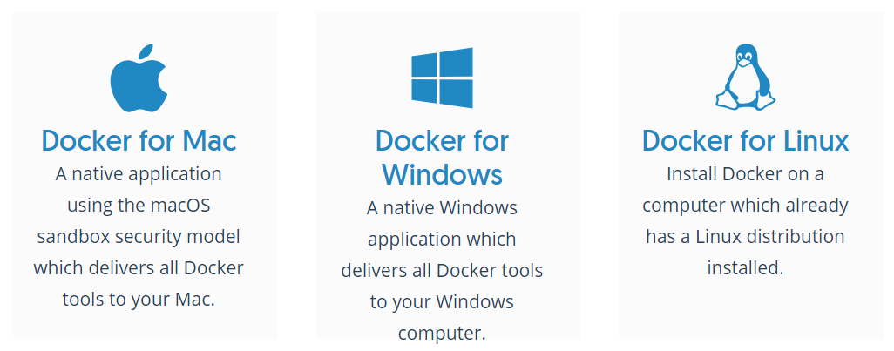
Supported Operating System

Slide 12
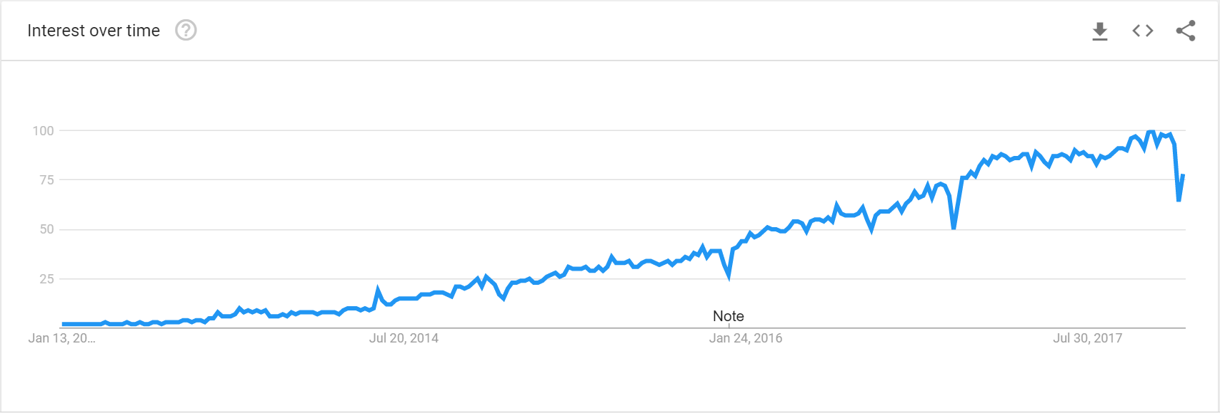
Interest on Docker – Google trends
https://trends.google.co.in/trends/explore?date=today%205-y&q=docker

Slide 13
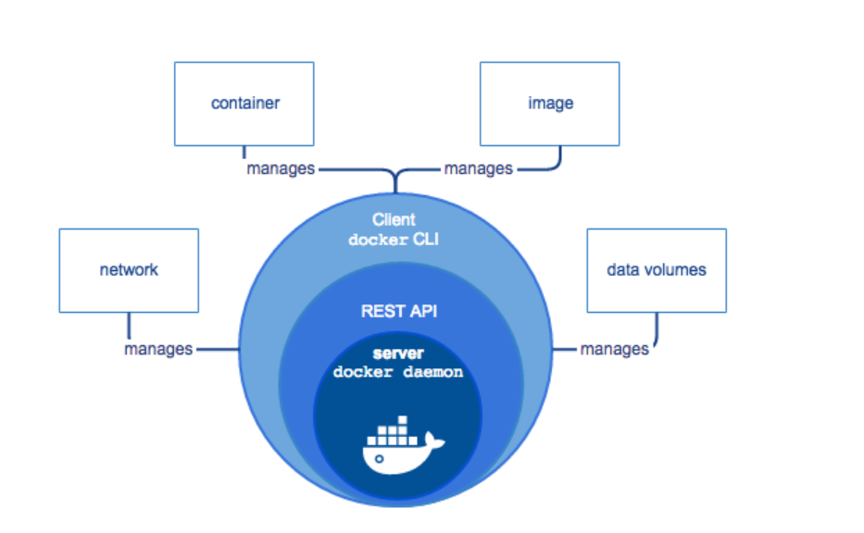
Docker Engine
Docker Engine is a client-server application with these major components:
A server which is a type of long-running program called a daemon process (the dockerd command).
A REST API which specifies interfaces that programs can use to talk to the daemon and instruct it what to do.
A command line interface (CLI) client ( the docker command).

Slide 14
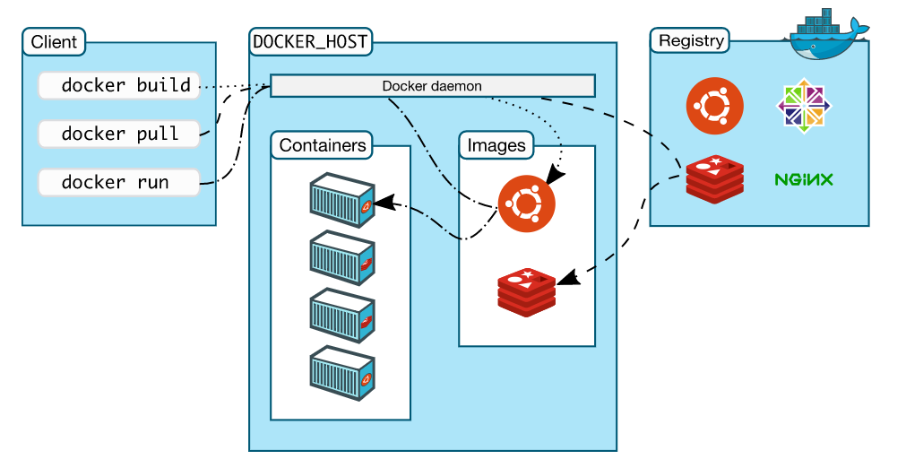
Docker architecture

Slide 15
Install Docker
Docker is available in two editions:
Community Edition (CE)
Enterprise Edition (EE).

Slide 16
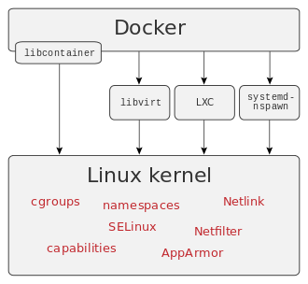
How docker access the linux kernel?

Slide 17
Docker Images vs Containers
Images:
lightweight, stand-alone, executable package
Includes everything needed to run a piece of software, including the code, a runtime, libraries, environment variables, and config files.
Container:
Runtime instance of an image—what the image becomes in memory when actually executed.

Slide 18
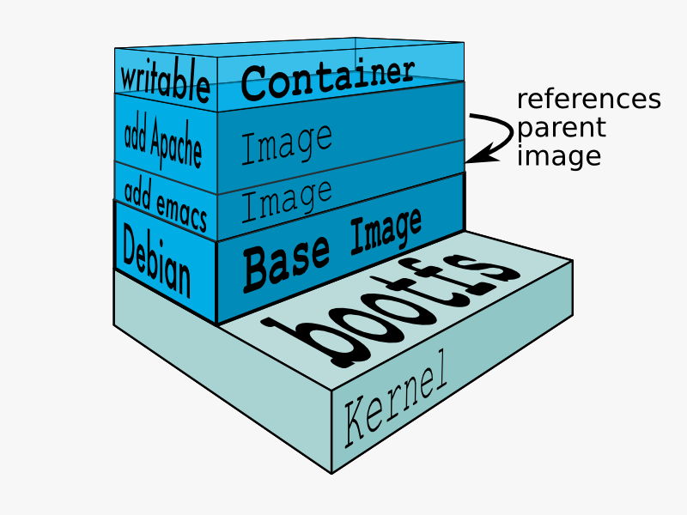
Docker Image

Slide 19
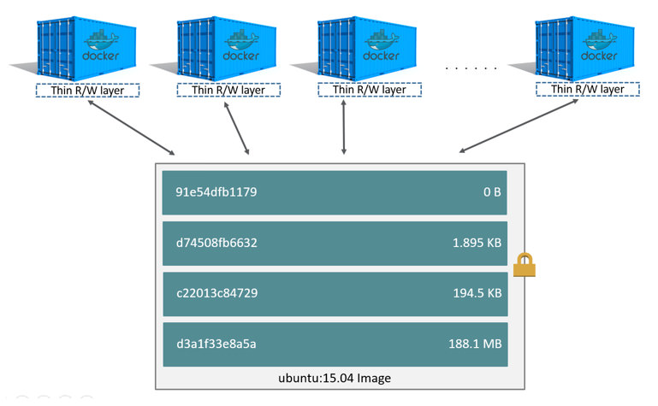
Sharing the docker image

Slide 20
Finding the Docker Version
Usage: “ docker version [OPTIONS] “
Show the Docker version information
$ docker version
Client:
Version: 17.12.0-ce
API version: 1.35
Go version: go1.9.2
Git commit: c97c6d6
Built: Wed Dec 27 20:11:19 2017
OS/Arch: linux/amd64
Server:
Engine:
Version: 17.12.0-ce
API version: 1.35 (minimum version 1.12)
Go version: go1.9.2
Git commit: c97c6d6
Built: Wed Dec 27 20:09:53 2017

Slide 21
Docker Installation information
Usage: “ Usage: docker info [OPTIONS] ”
Display system-wide information
$docker info
Containers: 1
Running: 0
Paused: 0
Stopped: 1
Images: 1
Server Version: 17.12.0-ce
Storage Driver: aufs
Root Dir: /var/lib/docker/aufs
Backing Filesystem: extfs
Dirs: 3
Dirperm1 Supported: true
Logging Driver: json-file
Cgroup Driver: cgroupfs
Plugins:

Slide 22
Run the first Container
Usage: “ docker run [OPTIONS] IMAGE [COMMAND] [ARG...] [flags] ”
Run a command in a new container
$ docker run docker/whalesay cowsay hello world
_____________
< hello world >
-------------
\
\
\
## .
## ## ## ==
## ## ## ## ===
/""""""""""""""""___/ ===
~~~ {~~ ~~~~ ~~~ ~~~~ ~~ ~ / ===- ~~~
\______ o __/
\ \ __/
\____\______/

Slide 23
List the Docker Images
Usage: “ docker images [OPTIONS] [REPOSITORY[:TAG]] ”
List images
$ docker images
REPOSITORY TAG IMAGE ID CREATED SIZE
hello-world latest f2a91732366c 7 weeks ago 1.85kB
docker/whalesay latest 6b362a9f73eb 2 years ago 247MB

Slide 24
Pull the Docker image from the Repository
Usage: “ docker pull [OPTIONS] NAME[:TAG|@DIGEST] “
Pull an image or a repository from a registry
$ docker pull hello-world
Using default tag: latest
latest: Pulling from library/hello-world
ca4f61b1923c: Pull complete
Digest: sha256:66ef312bbac49c39a89aa9bcc3cb4f3c9e7de3788c944158df3ee0176d32b751
Status: Downloaded newer image for hello-world:latest

Slide 25
How to pull all versions of a particular Image?
Options:
-a, --all-tags Download all tagged images in the repository
$ docker pull -a hello-world
latest: Pulling from library/hello-world
Digest: sha256:66ef312bbac49c39a89aa9bcc3cb4f3c9e7de3788c944158df3ee0176d32b751
linux: Pulling from library/hello-world
Digest: sha256:27f70fe1ab54eebd2569a33f0b86e5db42b8ebda65d0647d8eceb87d34462efd
nanoserver-1709: Pulling from library/hello-world
no matching manifest for linux/amd64 in the manifest list entries
$ docker images
REPOSITORY TAG IMAGE ID CREATED SIZE
hello-world latest f2a91732366c 7 weeks ago 1.85kB
hello-world linux f2a91732366c 7 weeks ago 1.85kB

Slide 26
Check the Digest of Images
Usage: “ docker images [OPTIONS] [REPOSITORY[:TAG]] “
List images
Options:
--digests Show digests
$ docker images –digests
REPOSITORY TAG DIGEST IMAGE ID CREATED SIZE
hello-world latest sha256:27f70fe1ab54eebd2569a33f0b86e5db42b8ebda65d0647d8eceb87d34462efd f2a91732366c 7 weeks ago 1.85kB
hello-world latest sha256:66ef312bbac49c39a89aa9bcc3cb4f3c9e7de3788c944158df3ee0176d32b751 f2a91732366c 7 weeks ago 1.85kB

Slide 27
Pull Image based on the specific version
Usage : “ docker pull NAME:TAG “
$ docker pull centos:6
6: Pulling from library/centos
ca9499a209fd: Pull complete
Digest: sha256:551de58ca434f5da1c7fc770c32c6a2897de33eb7fde7508e9149758e07d3fe3
Status: Downloaded newer image for centos:6

Slide 28
Filtering the Images [before]
Usage : “ docker images --filter name=value “
$ docker images --filter before=centos:7
REPOSITORY TAG IMAGE ID CREATED SIZE
hello-world latest f2a91732366c 7 weeks ago 1.85kB
hello-world linux f2a91732366c 7 weeks ago 1.85kB

Slide 29
Filtering the Images [since]
Usage : “ docker images --filter since=value “
$ docker images --filter since=hello-world
REPOSITORY TAG IMAGE ID CREATED SIZE
centos 6 609c1f9b5406 6 days ago 195MB
centos 7 ff426288ea90 6 days ago 207MB

Slide 30
View Full Image ID
Usage : “ docker images --no-trunk “
Option:
--no-trunc Don't truncate output
$ docker images --no-trunk
REPOSITORY TAG IMAGE ID CREATED SIZE
centos 6 sha256:609c1f9b5406a968c8ddeef0cc3384f59908f2ef65c4854ce9f0539acc0b16fb 6 days ago 195MB
centos 7 sha256:ff426288ea903fcf8d91aca97460c613348f7a27195606b45f19ae91776ca23d 6 days ago 207MB
hello-world latest sha256:f2a91732366c0332ccd7afd2a5c4ff2b9af81f549370f7a19acd460f87686bc7 7 weeks ago 1.85kB
hello-world linux sha256:f2a91732366c0332ccd7afd2a5c4ff2b9af81f549370f7a19acd460f87686bc7 7 weeks ago 1.85kB

Slide 31
Listing all Image IDs
Usage : “ docker images –q “
Option:
-q, --quiet Only show numeric IDs
$ docker images –q
609c1f9b5406
ff426288ea90
f2a91732366c
F2a91732366c

Slide 32
Searching the Image
Usage: “ docker search [OPTIONS] TERM “
Search the Docker Hub for images
$ docker search ubuntu
NAME DESCRIPTION STARS OFFICIAL AUTOMATED
ubuntu Ubuntu is a Debian-based Linux operating sys… 7106 [OK]
dorowu/ubuntu-desktop-lxde-vnc Ubuntu with openssh-server and NoVNC 156 [OK]
rastasheep/ubuntu-sshd Dockerized SSH service, built on top of offi… 127 [OK]
ansible/ubuntu14.04-ansible Ubuntu 14.04 LTS with ansible 90 [OK]
ubuntu-upstart Upstart is an event-based replacement for th… 80 [OK]
neurodebian NeuroDebian provides neuroscience research s… 41 [OK]
ubuntu-debootstrap debootstrap --variant=minbase --components=m… 34 [OK]

Slide 33
Filtering the Image while searching
Usage: “ docker search IMAGE –filter stars=NUMBER “
$ docker search ubuntu --filter stars=50
NAME DESCRIPTION STARS OFFICIAL AUTOMATED
ubuntu Ubuntu is a Debian-based Linux operating sys… 7106 [OK]
dorowu/ubuntu-desktop-lxde-vnc Ubuntu with openssh-server and NoVNC 156 [OK]
rastasheep/ubuntu-sshd Dockerized SSH service, built on top of offi… 127 [OK]
ansible/ubuntu14.04-ansible Ubuntu 14.04 LTS with ansible 90 [OK]
ubuntu-upstart Upstart is an event-based replacement for th… 80 [OK]

Slide 34
Filtering based on official repo
Usage: “ docker search IMAGE –filter is-official=true “
$ docker search ubuntu --filter is-official=true
NAME DESCRIPTION STARS OFFICIAL AUTOMATED
ubuntu Ubuntu is a Debian-based Linux operating sys… 7106 [OK]
ubuntu-upstart Upstart is an event-based replacement for th… 80 [OK]
neurodebian NeuroDebian provides neuroscience research s… 41 [OK]
ubuntu-debootstrap debootstrap --variant=minbase --components=m… 34 [OK]

Slide 35
Limiting the search results
Usage: “ docker search IMAGE –limit=NUMBER “
Option:
--limit int Max number of search results (default 25)
$ docker search ubuntu --limit=5
NAME DESCRIPTION STARS OFFICIAL AUTOMATED
ubuntu Ubuntu is a Debian-based Linux operating sys… 7106 [OK]
rastasheep/ubuntu-sshd Dockerized SSH service, built on top of offi… 127 [OK]
ubuntu-upstart Upstart is an event-based replacement for th… 80 [OK]
ubuntu-debootstrap debootstrap --variant=minbase --components=m… 34 [OK]
smartentry/ubuntu ubuntu with smartentry 0 [OK]

Slide 36
Tagging the Images
Usage: “ docker tag SOURCE_IMAGE[:TAG] TARGET_IMAGE[:TAG] “
Create a tag TARGET_IMAGE that refers to SOURCE_IMAGE
$ docker images
REPOSITORY TAG IMAGE ID CREATED SIZE
centos 6 609c1f9b5406 6 days ago 195MB
centos 7 ff426288ea90 6 days ago 207MB
hello-world latest f2a91732366c 7 weeks ago 1.85kB
hello-world linux f2a91732366c 7 weeks ago 1.85kB
rahulkrishnanfs/hello-world v1 f2a91732366c 7 weeks ago 1.85kB
$ docker tag centos:6 mylocalcentos:v1
$ docker images
REPOSITORY TAG IMAGE ID CREATED SIZE
centos 6 609c1f9b5406 6 days ago 195MB
mylocalcentos v1 609c1f9b5406 6 days ago 195MB
centos 7 ff426288ea90 6 days ago 207MB
hello-world latest f2a91732366c 7 weeks ago 1.85kB
hello-world linux f2a91732366c 7 weeks ago 1.85kB
rahulkrishnanfs/hello-world v1 f2a91732366c 7 weeks ago 1.85kB

Slide 37
Listing Image history
Usage: “ docker image history [OPTIONS] IMAGE [flags] “
Show the history of an image
$ docker image history hello-world
IMAGE CREATED CREATED BY SIZE COMMENT
f2a91732366c 7 weeks ago /bin/sh -c #(nop) CMD ["/hello"] 0B
<missing> 7 weeks ago /bin/sh -c #(nop) COPY file:f3dac9d5b1b0307f… 1.85kB

Slide 38
Exporting Image as tar file
Usage: “ docker image save [OPTIONS] IMAGE [IMAGE...] “
Save one or more images to a tar archive (streamed to STDOUT by default)
$ docker image save hello-world > hello-world.tar
$ tar -tvf hello-world.tar
drwxr-xr-x 0/0 0 2017-11-21 00:23 39657b261131182fd7c18d8cfb214df80bb7748ba0ed07bc2f12fcf28f49fe43/
-rw-r--r-- 0/0 3 2017-11-21 00:23 39657b261131182fd7c18d8cfb214df80bb7748ba0ed07bc2f12fcf28f49fe43/VERSION
-rw-r--r-- 0/0 1182 2017-11-21 00:23 39657b261131182fd7c18d8cfb214df80bb7748ba0ed07bc2f12fcf28f49fe43/json
-rw-r--r-- 0/0 3584 2017-11-21 00:23 39657b261131182fd7c18d8cfb214df80bb7748ba0ed07bc2f12fcf28f49fe43/layer.tar
-rw-r--r-- 0/0 1510 2017-11-21 00:23 f2a91732366c0332ccd7afd2a5c4ff2b9af81f549370f7a19acd460f87686bc7.json
-rw-r--r-- 0/0 227 1970-01-01 00:00 manifest.json
-rw-r--r-- 0/0 169 1970-01-01 00:00 repositories

Slide 39
Importing the docker image
Usage: docker import [OPTIONS] file|URL|- [REPOSITORY[:TAG]]
Import the contents from a tarball to create a filesystem image
$ docker import hello-world.tar imageimport:v1
sha256:ba8695369b16debcd1c836607aa081c387e07a6bb8e798d8a058c6a4c5d84e65
ubuntu@ip-172-31-47-175:/tmp$ docker images
REPOSITORY TAG IMAGE ID CREATED SIZE
imageimport v1 ba8695369b16 7 seconds ago 6.67kB

Slide 40
Importing the docker image contd..
Usage: “ docker load [OPTIONS] “
Load an image from a tar archive or STDIN
Import the contents from a tarball to create a filesystem image
$ docker load < hello-world.tar
f999ae22f308: Loading layer [==================================================>] 3.584kB/3.584kB
Loaded image: hello-world:latest
Loaded image: hello-world:linux

Slide 41
Removing Dangling Images
Usage: “ docker image prune [OPTIONS] “
Remove unused images
$ docker image prune
WARNING! This will remove all dangling images.
Are you sure you want to continue? [y/N] y
Total reclaimed space: 0B

Slide 42
Inspecting the docker image
Usage: “ docker image inspect [OPTIONS] IMAGE [IMAGE...] “
Display detailed information on one or more images
$ docker image inspect hello-world:latest
[
{
"Id": "sha256:f2a91732366c0332ccd7afd2a5c4ff2b9af81f549370f7a19acd460f87686bc7",
"RepoTags": [
"hello-world:latest",
"hello-world:linux"
],
"RepoDigests": [],
"Parent": "",
"Comment": "",
"Created": "2017-11-21T00:23:18.797567713Z",
"Container": "fb0b4536aac3a96065e1bedb2b637a6019feec666c7699592206956c9d3adf5f",

Slide 43
Extracting the docker image information using - - format
Usage: “ docker image inspect [OPTIONS] IMAGE [IMAGE...] “
Display detailed information on one or more images
Options:
-f, --format string Format the output using the given Go template
$ docker image inspect hello-world:latest --format="{{ .ContainerConfig.Hostname }}“
Fb0b4536aac3

Slide 44
Extracting the docker image information using - - format and output in JSON
$ docker image inspect hello-world:latest --format="{{ json .ContainerConfig }}"| jq
{
"Hostname": "fb0b4536aac3",
"Domainname": "",
"User": "",
"AttachStdin": false,
"AttachStdout": false,
"AttachStderr": false,
"Tty": false,
"OpenStdin": false,
"StdinOnce": false,
"Env": [
"PATH=/usr/local/sbin:/usr/local/bin:/usr/sbin:/usr/bin:/sbin:/bin"
],
"Cmd": [
"/bin/sh",
"-c",
"#(nop) ",
"CMD [\"/hello\"]"
],
"ArgsEscaped": true,
"Image": "sha256:2243ee460b69c4c036bc0e42a48eaa59e82fc7737f7c9bd2714f669ef1f8370f",
"Volumes": null,
"WorkingDir": "",
"Entrypoint": null,
"OnBuild": null,
"Labels": {}
}

Slide 45
Listing the Docker Containers
Usage: docker ps [OPTIONS]
List containers
$ docker ps
CONTAINER ID IMAGE COMMAND CREATED STATUS PORTS NAMES

Slide 46
Listing the Stopped Docker Containers
Usage: docker ps – a
Option:
-a, --all Show all containers (default shows just running)
$ docker ps –a
CONTAINER ID IMAGE COMMAND CREATED STATUS PORTS NAMES
496d54f4954d centos:6 "/bin/bash" 6 seconds ago Exited (0) 5 seconds ago unruffled_stallman
0e7e850264ae centos:6 "/bin/bash" 19 seconds ago Exited (0) 18 seconds ago xenodochial_jepsen

Slide 47
Giving Name to the container
Usage: “ docker run –name NAME IMAGE “
Option:
--name string Assign a name to the container
$ docker run --name httpd httpd
Unable to find image 'httpd:latest' locally
latest: Pulling from library/httpd
f49cf87b52c1: Pull complete
02ca099fb6cd: Pull complete
de7acb18da57: Pull complete
770c8edb393d: Pull complete
0e252730aeae: Pull complete
6e6ca341873f: Pull complete
2daffd0a6144: Pull complete
Digest: sha256:b5f21641a9d7bbb59dc94fb6a663c43fbf3f56270ce7c7d51801ac74d2e70046
Status: Downloaded newer image for httpd:latest
8110357872ad419649ffee18638285657a21df3bc3fc14a0c8852594b1be40a4

Slide 48
Passing Environment Variable and Values
$ docker run -it --name httpd --env name=value IMAGE [COMMAND] [ARG...]
Option:
-e, --env list Set environment variables
$ docker run -it --name httpd --env myvar=hello httpd /bin/bash
root@fec06ea0fae1:/usr/local/apache2# env
HTTPD_PATCHES=
HTTPD_PREFIX=/usr/local/apache2
myvar=hello

Slide 49
Running Container in Background
Usage: “ docker run -d IMAGE [COMMAND] [ARG...] “
Option:
-d, --detach Run container in background and print container ID
$ docker run -d --name httpd httpd
b5d99eb702f6be24615c4d40a3f3441a46edd4167938065a685f43189197c642
ubuntu@ip-172-31-47-175:~$ docker ps
CONTAINER ID IMAGE COMMAND CREATED STATUS PORTS NAMES
b5d99eb702f6 httpd "httpd-foreground" 3 seconds ago Up 2 seconds 80/tcp httpd

Slide 50


Slide 51
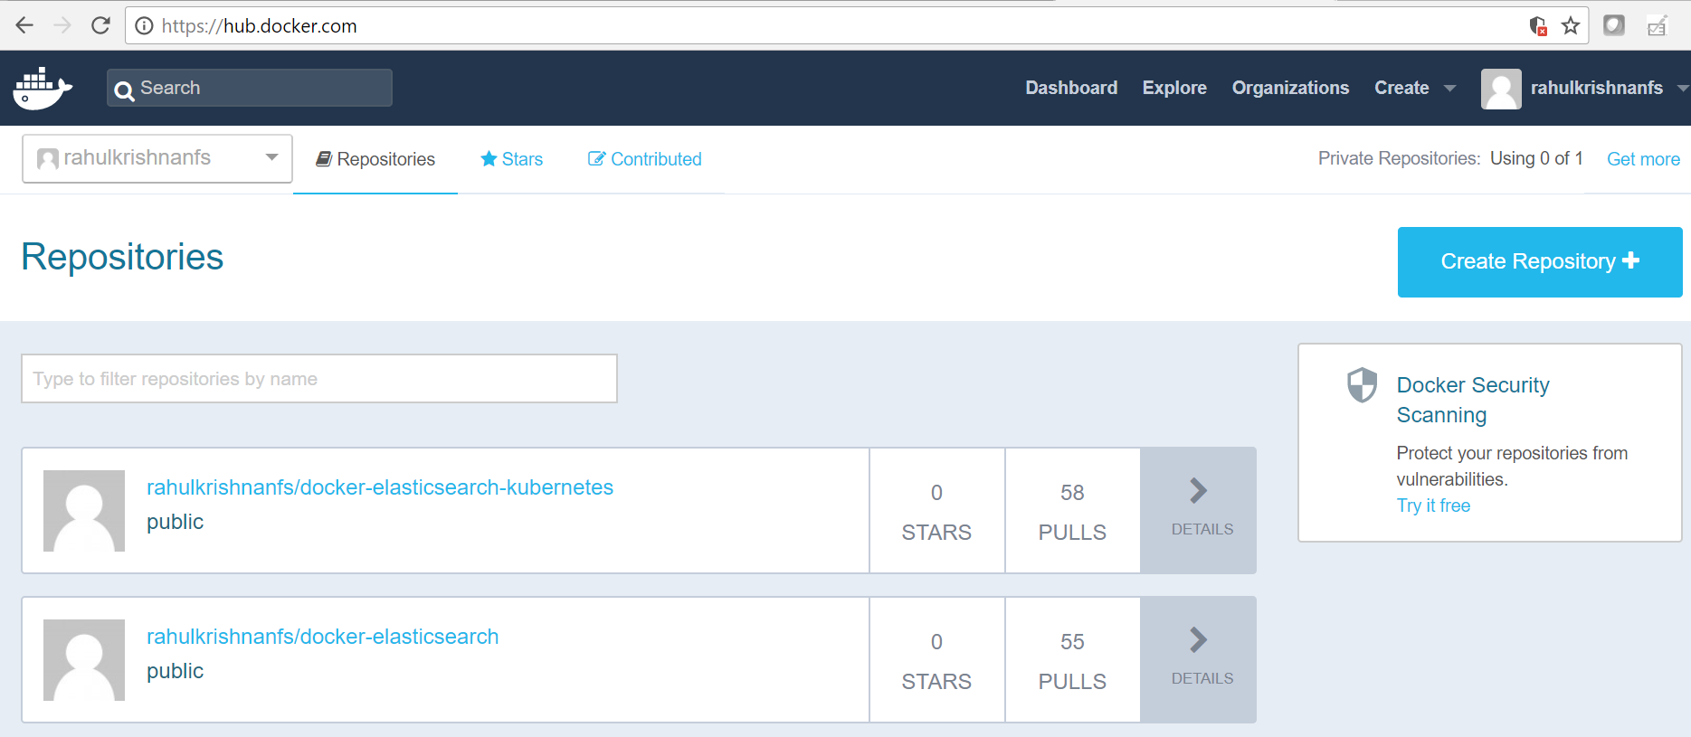
How docker hub looks like?

Slide 52
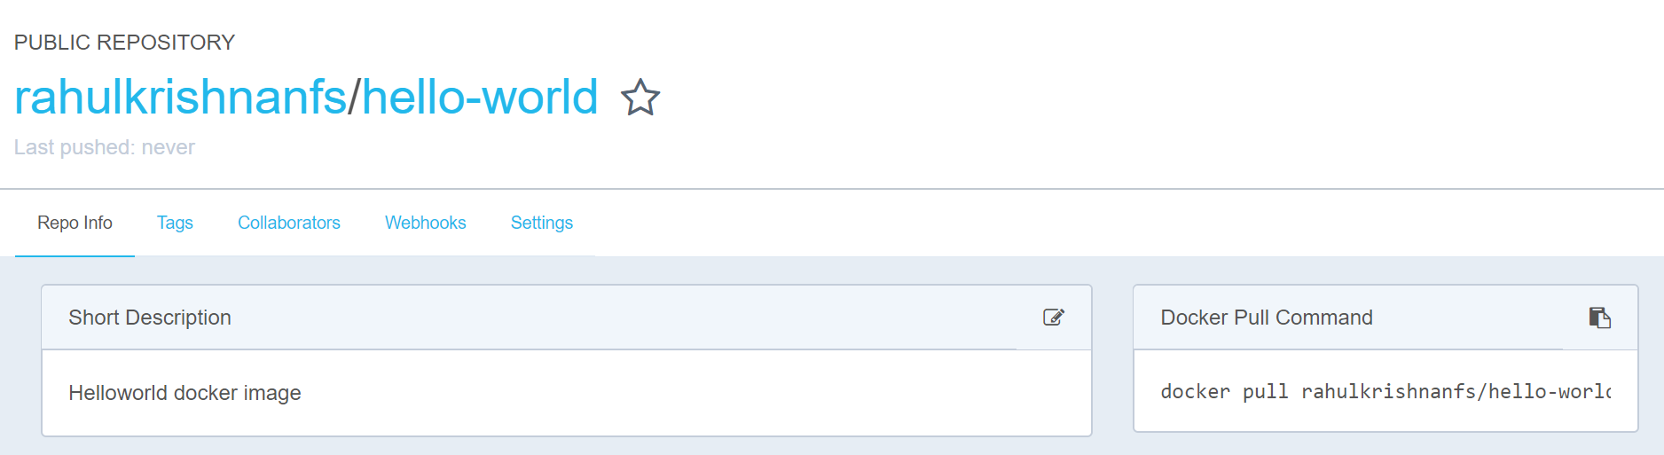
How repository looks like?

Slide 53
Demo

Slide 54
Tagging the docker image
$ docker images
REPOSITORY TAG IMAGE ID CREATED SIZE
centos 6 609c1f9b5406 6 days ago 195MB
centos 7 ff426288ea90 6 days ago 207MB
hello-world latest f2a91732366c 7 weeks ago 1.85kB
hello-world linux f2a91732366c 7 weeks ago 1.85kB
$ docker tag hello-world:latest rahulkrishnanfs/hello-world:v1

Slide 55
Login to docker hub
$ docker login
Login with your Docker ID to push and pull images from Docker Hub. If you don't have a Docker ID, head over to https://hub.docker.com to create one.
Username :
Password:

Slide 56
Pushing the image to docker hub after tagging
$ docker push rahulkrishnanfs/hello-world:v1
The push refers to repository [docker.io/rahulkrishnanfs/hello-world]
f999ae22f308: Pushed
v1: digest: sha256:8072a54ebb3bc136150e2f2860f00a7bf45f13eeb917cca2430fcd0054c8e51b size: 524

Slide 58
FROM Sets the Base Image for subsequent instructions.
RUN Execute any commands in a new layer on top of the current image and commit the results.
CMD Provide defaults for an executing container.
EXPOSE Informs Docker that the container listens on the specified network ports at runtime.
ENV Sets environment variable.
ADD Copies new files, directories or remote file to container. Invalidates caches. Avoid ADD and use COPY instead.
COPY Copies new files or directories to container.
ENTRYPOINT Configures a container that will run as an executable.
VOLUME Creates a mount point for externally mounted volumes or other containers.
USER Sets the user name for following RUN / CMD / ENTRYPOINT commands.
WORKDIR Sets the working directory.
ARG Defines a build-time variable.

Slide 59
Demo

Slide 60


Slide 61
Installation of Docker Compose
$ curl -L https://github.com/docker/compose/releases/download/1.18.0/docker-compose-`uname -s`-`uname -m` \
-o /usr/local/bin/docker-compose
$ chmod +x /usr/local/bin/docker-compose
$ docker-compose –version

Slide 62
Docker Compose Workflow
Compose is a tool for defining and running multi-container Docker applications
There are three steps to use Docker Compose:
Define each service in a Dockerfile.
Define the services and their relation to each other in the docker-compose.yml file.
Use docker-compose up to start the system.

Slide 63
Wordpress Deployment using docker compose
version: '3'
services:
db:
image: mysql:5.7
volumes:
- db_data:/var/lib/mysql
restart: always
environment:
MYSQL_ROOT_PASSWORD: somewordpress
MYSQL_DATABASE: wordpress
MYSQL_USER: wordpress
MYSQL_PASSWORD: wordpress
wordpress:
depends_on:
- db
image: wordpress:latest
ports:
- "8000:80"
restart: always
environment:
WORDPRESS_DB_HOST: db:3306
WORDPRESS_DB_USER: wordpress
WORDPRESS_DB_PASSWORD: wordpress
volumes:
db_data:

Slide 64
Demo

Slide 65
Docker Networking

Slide 66
Default networks
When install Docker, it creates three networks automatically.
$ docker network ls
NETWORK ID NAME DRIVER SCOPE
4c857f10b40b bridge bridge local
59cc999607b5 host host local
eecbbc6166ba none null local

Slide 67
Inspecting the network configurations
$ sudo docker inspect network bridge
[
{
"Name": "bridge",
"Id": "4c857f10b40bc8e467de686d72c21ce352e8e6f2e69d09f425982f5a778f3542",
"Created": "2018-01-09T06:41:37.783207218Z",
"Scope": "local",
"Driver": "bridge",
"EnableIPv6": false,
"IPAM": {
"Driver": "default",
"Options": null,
"Config": [
{
"Subnet": "172.17.0.0/16",
"Gateway": "172.17.0.1"
}
]
},
"Internal": false,
"Attachable": false,
"Ingress": false,
"ConfigFrom": {
"Network": ""
},
"ConfigOnly": false,
"Containers": {},
"Options": {
"com.docker.network.bridge.default_bridge": "true",
"com.docker.network.bridge.enable_icc": "true",
"com.docker.network.bridge.enable_ip_masquerade": "true",
"com.docker.network.bridge.host_binding_ipv4": "0.0.0.0",
"com.docker.network.bridge.name": "docker0",
"com.docker.network.driver.mtu": "1500"
},
"Labels": {}
}
]

Slide 68
Fetching the IP address of the container
CONTAINER ID IMAGE COMMAND CREATED STATUS PORTS NAMES
adbb3d5c2556 httpd "httpd-foreground" 3 minutes ago Up 3 minutes 80/tcp httpd
e4bb208f66c9 nginx "nginx -g 'daemon of…" 24 hours ago Up 24 hours 80/tcp affectionate_minsky
$ docker container inspect --format="{{ .NetworkSettings.Networks.bridge.IPAddress }}" httpd
172.17.0.3

Slide 69
Manually Creating the Network
$ docker network create --driver=bridge --subnet="192.168.1.0/24" --opt "com.docker.network.driver.mtu"="1500" devel
$ docker network ls
NETWORK ID NAME DRIVER SCOPE
4c857f10b40b bridge bridge local
671fce98a130 devel bridge local
59cc999607b5 host host local
eecbbc6166ba none null local

Slide 70
Adding Running container to the new network
$ docker network connect devel httpd
$ docker container inspect --format="{{ .NetworkSettings.Networks.bridge.IPAddress }}" httpd
172.17.0.3
$ docker container inspect --format="{{ .NetworkSettings.Networks.devel.IPAddress }}" httpd
192.168.1.2

Slide 71
Adding DNS to the container
$ docker run --name=httpd -d --dns=8.8.8.8 --dns=4.4.4.4 httpd
5cf4549f6f5cb47133f7993e04b48f91a3d64c89a11c25d9cd2b9394a94cd6d3
root@5cf4549f6f5c:/usr/local/apache2# cat /etc/resolv.conf
search ec2.internal
nameserver 8.8.8.8
nameserver 4.4.4.4
root@5cf4549f6f5c:/usr/local/apache2#

Slide 72
Globally changing the adding the dns configuration
$ cat /etc/docker/daemon.json
{
"dns":["8.8.8.8", "8.8.4.4"]
}
# systemctl stop docker.service
# systemctl start docker.service
$ docker run -it --name=httpd httpd /bin/bash
root@c0b9507ad98d:/usr/local/apache2:~# cat /etc/resolv.conf
search ec2.internal
nameserver 8.8.8.8
nameserver 8.8.4.4

Slide 73
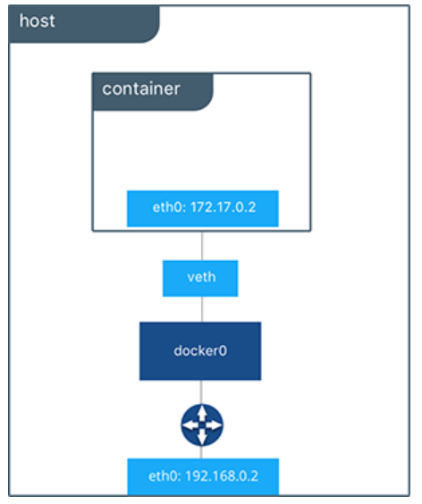
How network looks like?

Slide 74
Volume Creation
Usage: “ docker volume create [OPTIONS] [VOLUME] “
Create a volume
$ docker volume create vol1
$ docker inspect vol1
[
{
"CreatedAt": "2018-01-16T12:33:33Z",
"Driver": "local",
"Labels": {},
"Mountpoint": "/var/lib/docker/volumes/vol1/_data",
"Name": "vol1",
"Options": {},
"Scope": "local"
}
]

Slide 76
Docker Machine Commands
docker-machine create --driver virtualbox <name>
docker-machine ls
docker-machine ssh <name>
docker-machine ip <name>
docker-machine stop <name>
docker-machine start <name>

Slide 77
More Information
https://docs.docker.com/
https://github.com/moby/moby
dockercommunity.slack.com

Slide 78

Questions??

Slide 79
Thank you !!
@rahulkrishnanra

